Slide 1


SC1007
Data Structures & Algorithms in Python
Lab 1 – Linked Lists
Lab Group SR3
2:30pm – 4:20pm
College of Computing and Data Science

Slide 2
Data Structures & Algorithms in Python
Linked Lists – Lab Answers
Alistair Yong Jia Jin
College of Computing and Data Science

Slide 3
Linked Lists
A LinkedList consists of a connected sequence of Link/Node objects
Each node contains a reference to a datum and a reference to the next node in the sequence.
  The datum is just an object. It could be just an int or a string, or it could contain a key/data pair.
The last node in the sequence refers to None as its next node
The sequence of nodes is accessed via a “header” object that contains a reference to the first node in the sequence.
head
0x1000
0x1010
0x1020
0x1030
0x10??
John
18
4.0
Anna
21
3.5
Peter
22
3.8
Jane
25
3.7
…
Last
45
4.5
None
0x1010
0x1020
0x1030
Notes:
Here we analyze the basic anatomy of a LinkedList. It consists of a series of interconnected nodes, where each node contains two parts: a reference to the data it holds and a reference to the next node in the sequence.
The data can be any object, such as an integer, a string, or a key-value pair. Each node is linked to the next one in line through its reference, creating a chain of connected nodes. The last node in this sequence points to None, indicating the end of the list. The entire structure is accessed via a header object, which holds a reference to the first node in the list. If the reference to this header is lost, the entire list becomes inaccessible.

Slide 4
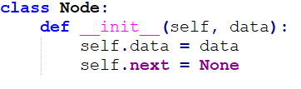

Linked Lists
head
1
2
3
4
5

Slide 5
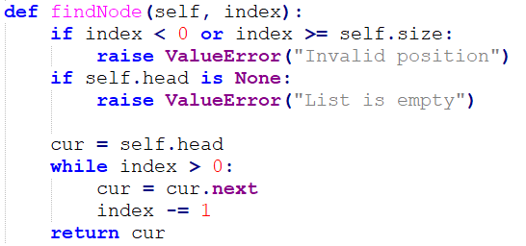
Linked Lists
index = 2
index = 1
index = 0
cur
head
1
2
3
4
5

Slide 6
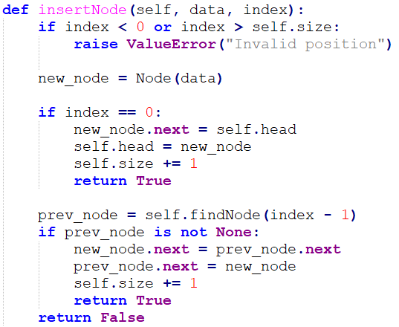
Linked Lists
index = 0
7
head
1
2
3
4
5

Slide 7
Linked Lists
index = 3
prev_node
7
head
1
2
3
4
5

Slide 8
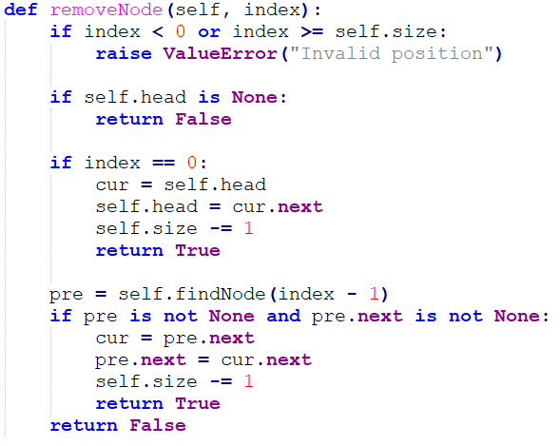
Linked Lists
index = 0
cur
head
1
2
3
4
5

Slide 9
Linked Lists
index = 2
pre
cur
head
1
2
3
4
5

Slide 10
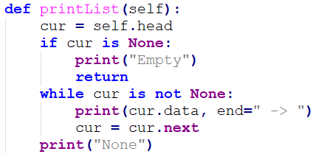
Linked Lists
cur
head
1
2
3
4
5

Slide 11
Q01 (No AI)
Split Linked List
Write a function split() that separates the values of a list into two groups based on their position. The function prototype is given below:
def split(head):
The function should collect values at even indices (0, 2, 4, etc.) into an even list and values at odd indices (1, 3, 5, etc.) into an odd list. The original input should remain unmodified.
Sample Input: head [10, 20, 30, 40, 50]
Sample Output: {"even": [10, 30, 50], "odd": [20, 40]}
Explanation: The linked list is constructed from the given array, with the head reference pointing to the first node: head → 10 → 20 → 30 → 40 → 50 Starting from the head, the nodes are visited one by one, tracking each node's position (0-based index): 10 at index 0, 20 at index 1, 30 at index 2, 40 at index 3, and 50 at index 4. Nodes at even positions (0, 2, 4) — values 10, 30, 50 — are collected into the even list. Nodes at odd positions (1, 3) — values 20, 40 — are collected into the odd list. The original linked list itself is left unmodified; only the two new lists are built from it. Therefore, the output is: {"even": [10, 30, 50], "odd": [20, 40]}

Slide 12
Q02 (Normal)
Move Odd Items to Back
Write a function moveOdditemstoback() that moves all odd integers to the back of a linked list, while keeping even integers in their original relative order at the front and odd integers in their original relative order at the back. The function prototype is given below:
def moveOdditemstoback(head):
Sample Input and Output
Example 1: Input: head [1,2,3,4,5,6,7,8,9]
Output: [2,4,6,8,1,3,5,7,9]
Example 2: Input: head [2,7,18,3,4,15]
Output: [2,18,4,7,3,15]
Explanation The linked list is constructed from the given array, with the head reference pointing to the first node. Example 1: head → 1 → 2 → 3 → 4 → 5 → 6 → 7 → 8 → 9 Starting from the head, each node is visited in order and routed into one of two groups based on whether its value is even or odd, while preserving the relative order within each group. The even values — 2, 4, 6, 8 — form one group, and the odd values — 1, 3, 5, 7, 9 — form the other. The even group is then joined to the front, followed by the odd group at the back. Therefore, the output is: [2, 4, 6, 8, 1, 3, 5, 7, 9]

Slide 13
Q03 (Driver)
Cycle Length
Write the function cycleLength() using the LinkedList structure defined in the lecture materials. The function should determine whether a singly linked list contains a cycle. If a cycle exists, the function should return the length of the cycle. If the linked list does not contain a cycle, the function should return 0. The function prototype:
def cycleLength(head):
You may assume that the linked list has already been constructed and that the head parameter refers to the first node in the list. Each test case also includes an index value pos, which is used to construct the list: it indicates the position (0-based) that the last node's next reference points back to, creating a cycle. If pos is -1, the last node points to None and the list has no cycle. Note that pos is only used to build the list — it is not passed to your function.
Sample Input and Output
Input: head {"pos": 2, "values": [1, 2, 3, 4, 5]}
Output: 3
Explanation The linked list is constructed from values in the given order, with the head reference pointing to the first node: head → 1 → 2 → 3 → 4 → 5 pos = 2 indicates that the next reference of the last node (value 5) points back to the node at index 2 (0-based), which is the node with value 3. This creates a cycle starting at node 3. Since there are 3 nodes in the cycle, the length of the cycle is 3. Therefore, the output is: 3

Slide 14
Q04 (Navigator)
Is Palindrome
Write the function isPalindrome() using the LinkedList structure defined in the lecture materials. The function should determine whether a singly linked list is a palindrome. A singly linked list is considered a palindrome if the sequence of node values is the same when read from the head to the end and from the end back to the head. If the linked list is a palindrome, return True. Otherwise, return False. The function prototype:
def isPalindrome(head):
You may assume that the linked list has already been constructed and that the head parameter refers to the first node in the list. You must not use any additional data structures (such as stacks, arrays, lists, or auxiliary linked lists). Your solution should use only pointer manipulation on the existing linked list nodes.
Sample Input and Output
Input: head [1, 2, 3, 2, 1]
Output: true
Explanation The linked list is constructed from the given array, with the head reference pointing to the first node: head → 1 → 2 → 3 → 2 → 1 Starting from the head, the linked list contains the sequence of values 1, 2, 3, 2, 1. When the sequence is read in reverse order, the values remain the same. Since the forward and backward sequences are identical, the linked list is a palindrome. Therefore, the output is: true

Slide 15
Lab Access Code

Slide 16
Q01 (No AI) – Answer
Split Linked List
Write a function split() that separates the values of a list into two groups based on their position. The function prototype is given below:
def split(head):
The function should collect values at even indices (0, 2, 4, etc.) into an even list and values at odd indices (1, 3, 5, etc.) into an odd list. The original input should remain unmodified.
Sample Input: head [10, 20, 30, 40, 50]
Sample Output: {"even": [10, 30, 50], "odd": [20, 40]}
Explanation: The linked list is constructed from the given array, with the head reference pointing to the first node: head → 10 → 20 → 30 → 40 → 50 Starting from the head, the nodes are visited one by one, tracking each node's position (0-based index): 10 at index 0, 20 at index 1, 30 at index 2, 40 at index 3, and 50 at index 4. Nodes at even positions (0, 2, 4) — values 10, 30, 50 — are collected into the even list. Nodes at odd positions (1, 3) — values 20, 40 — are collected into the odd list. The original linked list itself is left unmodified; only the two new lists are built from it. Therefore, the output is: {"even": [10, 30, 50], "odd": [20, 40]}

Slide 17
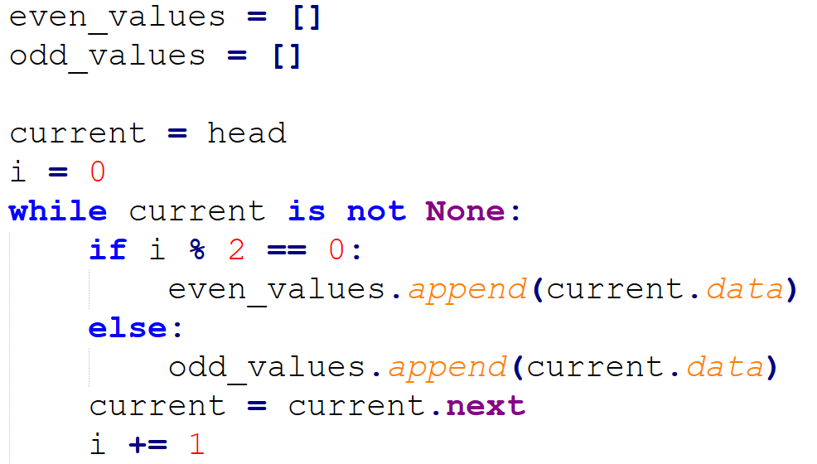
Q01 (No AI) – Answer

Slide 18
Q01 (No AI) – Answer

Slide 19
Q01 (No AI) – Answer

Slide 20
Q01 (No AI) – Answer

Slide 21
Q02 (Normal) – Answer
Move Odd Items to Back
Write a function moveOdditemstoback() that moves all odd integers to the back of a linked list, while keeping even integers in their original relative order at the front and odd integers in their original relative order at the back. The function prototype is given below:
def moveOdditemstoback(head):
Sample Input and Output
Example 1: Input: head [1,2,3,4,5,6,7,8,9]
Output: [2,4,6,8,1,3,5,7,9]
Example 2: Input: head [2,7,18,3,4,15]
Output: [2,18,4,7,3,15]
Explanation The linked list is constructed from the given array, with the head reference pointing to the first node. Example 1: head → 1 → 2 → 3 → 4 → 5 → 6 → 7 → 8 → 9 Starting from the head, each node is visited in order and routed into one of two groups based on whether its value is even or odd, while preserving the relative order within each group. The even values — 2, 4, 6, 8 — form one group, and the odd values — 1, 3, 5, 7, 9 — form the other. The even group is then joined to the front, followed by the odd group at the back. Therefore, the output is: [2, 4, 6, 8, 1, 3, 5, 7, 9]

Slide 22
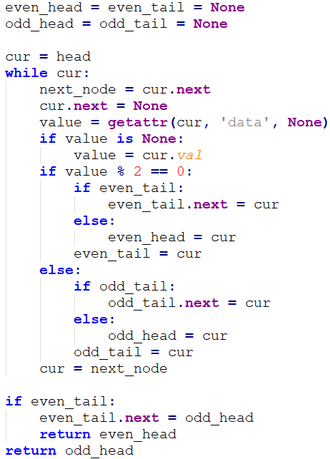
Q02 (Normal) – Answer
1
2
3
4
5
6

Slide 23
Q02 (Normal) – Answer
cur
1
2
3
4
5
6

Slide 24
Q02 (Normal) – Answer
cur
next_node
1
2
3
4
5
6

Slide 25
Q02 (Normal) – Answer
cur
next_node
1
2
3
4
5
6

Slide 26
Q02 (Normal) – Answer
cur
next_node
1
2
3
4
5
6

Slide 27
Q02 (Normal) – Answer
cur
next_node
2
3
4
5
6
1
odd_head

Slide 28
Q02 (Normal) – Answer
cur
next_node
2
3
4
5
6
1
odd_head
odd_tail

Slide 29
Q02 (Normal) – Answer
cur
next_node
2
3
4
5
6
1
odd_head
odd_tail

Slide 30
Q02 (Normal) – Answer
cur
next_node
2
3
4
5
6
1
odd_head
odd_tail

Slide 31
Q02 (Normal) – Answer
cur
next_node
3
4
5
6
1
odd_head
odd_tail
2
even_head
even_tail

Slide 32
Q02 (Normal) – Answer
cur
next_node
3
4
5
6
1
odd_head
odd_tail
2
even_head
even_tail

Slide 33
Q02 (Normal) – Answer
cur
next_node
3
4
5
6
1
odd_head
odd_tail
2
even_head
even_tail

Slide 34
Q02 (Normal) – Answer
cur
next_node
4
5
6
1
3
odd_head
odd_tail
2
even_head
even_tail

Slide 35
Q02 (Normal) – Answer
cur
next_node
4
5
6
1
3
odd_head
odd_tail
2
even_head
even_tail

Slide 36
Q02 (Normal) – Answer
cur
next_node
4
5
6
1
3
odd_head
odd_tail
2
even_head
even_tail

Slide 37
Q02 (Normal) – Answer
cur
next_node
5
6
1
3
odd_head
odd_tail
2
4
even_head
even_tail

Slide 38
Q02 (Normal) – Answer
cur
next_node
6
1
3
5
odd_head
odd_tail
2
4
even_head
even_tail

Slide 39
Q02 (Normal) – Answer
cur
1
3
5
odd_head
odd_tail
2
4
6
even_head
even_tail

Slide 40
Q02 (Normal) – Answer
1
3
5
odd_head
odd_tail
2
4
6
even_head
even_tail

Slide 41
Q03 (Driver) – Answer
Cycle Length
Write the function cycleLength() using the LinkedList structure defined in the lecture materials. The function should determine whether a singly linked list contains a cycle. If a cycle exists, the function should return the length of the cycle. If the linked list does not contain a cycle, the function should return 0. The function prototype:
def cycleLength(head):
You may assume that the linked list has already been constructed and that the head parameter refers to the first node in the list. Each test case also includes an index value pos, which is used to construct the list: it indicates the position (0-based) that the last node's next reference points back to, creating a cycle. If pos is -1, the last node points to None and the list has no cycle. Note that pos is only used to build the list — it is not passed to your function.
Sample Input and Output
Input: head {"pos": 2, "values": [1, 2, 3, 4, 5]}
Output: 3
Explanation The linked list is constructed from values in the given order, with the head reference pointing to the first node: head → 1 → 2 → 3 → 4 → 5 pos = 2 indicates that the next reference of the last node (value 5) points back to the node at index 2 (0-based), which is the node with value 3. This creates a cycle starting at node 3. Since there are 3 nodes in the cycle, the length of the cycle is 3. Therefore, the output is: 3

Slide 42
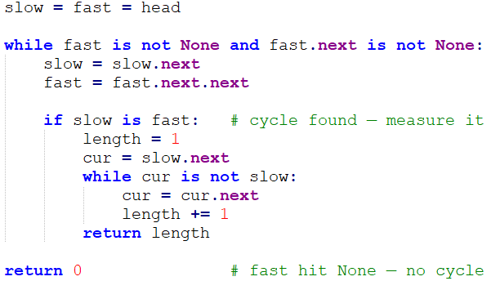
Q03 (Driver) – Answer
Floyd's cycle-finding algorithm
Notes:
Floyd's cycle-finding algorithm

Slide 43
Q03 (Driver) – Answer
Floyd's cycle-finding algorithm
1
2
3
4
5
6
pos = 2
Notes:
Floyd's cycle-finding algorithm

Slide 44
Q03 (Driver) – Answer
Floyd's cycle-finding algorithm
1
2
3
4
5
6
fast
slow
Notes:
Floyd's cycle-finding algorithm

Slide 45
Q03 (Driver) – Answer
Floyd's cycle-finding algorithm
1
2
3
4
5
6
slow
fast
Notes:
Floyd's cycle-finding algorithm

Slide 46
Q03 (Driver) – Answer
Floyd's cycle-finding algorithm
1
2
3
4
5
6
slow
fast
Notes:
Floyd's cycle-finding algorithm

Slide 47
Q03 (Driver) – Answer
Floyd's cycle-finding algorithm
1
2
3
4
5
6
fast
slow
Notes:
Floyd's cycle-finding algorithm

Slide 48
Q03 (Driver) – Answer
Floyd's cycle-finding algorithm
1
2
3
4
5
6
fast
cur
slow
Notes:
Floyd's cycle-finding algorithm

Slide 49
Q03 (Driver) – Answer
Floyd's cycle-finding algorithm
1
2
3
4
5
6
cur
fast
slow
Notes:
Floyd's cycle-finding algorithm

Slide 50
Q03 (Driver) – Answer
Floyd's cycle-finding algorithm
1
2
3
4
5
6
cur
slow
Notes:
Floyd's cycle-finding algorithm

Slide 51
Q04 (Navigator) – Answer
Is Palindrome
Write the function isPalindrome() using the LinkedList structure defined in the lecture materials. The function should determine whether a singly linked list is a palindrome. A singly linked list is considered a palindrome if the sequence of node values is the same when read from the head to the end and from the end back to the head. If the linked list is a palindrome, return True. Otherwise, return False. The function prototype:
def isPalindrome(head):
You may assume that the linked list has already been constructed and that the head parameter refers to the first node in the list. You must not use any additional data structures (such as stacks, arrays, lists, or auxiliary linked lists). Your solution should use only pointer manipulation on the existing linked list nodes.
Sample Input and Output
Input: head [1, 2, 3, 2, 1]
Output: true
Explanation The linked list is constructed from the given array, with the head reference pointing to the first node: head → 1 → 2 → 3 → 2 → 1 Starting from the head, the linked list contains the sequence of values 1, 2, 3, 2, 1. When the sequence is read in reverse order, the values remain the same. Since the forward and backward sequences are identical, the linked list is a palindrome. Therefore, the output is: true

Slide 52
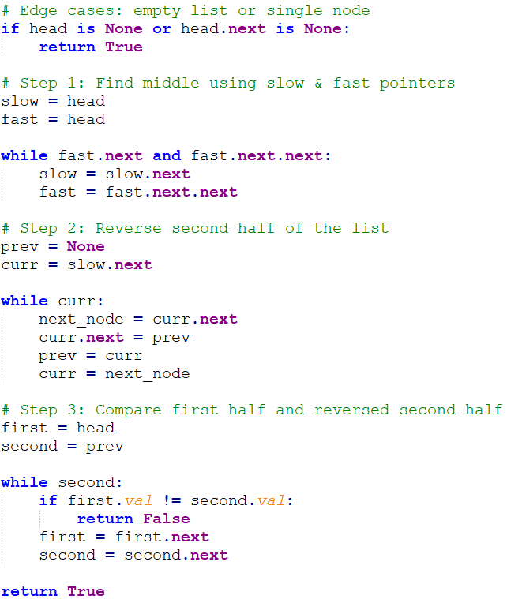
Q04 (Navigator) – Answer
1
2
3
3
2
1

Slide 53
Q04 (Navigator) – Answer
1
2
3
3
2
1

Slide 54
Q04 (Navigator) – Answer
1
2
3
1
2
3

Slide 55
Q04 (Navigator) – Answer
1
2
3
1
2
3

Slide 56
Q02 (Normal) – Answer
while current:
next_node = current.next
current.next = None
current
next_node
if current.data % 2 == 0:
if not even_head:
even_head = current
even_tail = current
else:
even_tail.next = current
even_tail = current
else:
if not odd_head:
odd_head = current
odd_tail = current
else:
odd_tail.next = current
odd_tail = current
current = next_node
1
3
5
2
4
6

Slide 57
Q02 (Normal) – Answer
while current:
next_node = current.next
current.next = None
current
next_node
if current.data % 2 == 0:
if not even_head:
even_head = current
even_tail = current
else:
even_tail.next = current
even_tail = current
else:
if not odd_head:
odd_head = current
odd_tail = current
else:
odd_tail.next = current
odd_tail = current
current = next_node
1
3
5
2
4
6

Slide 58
Q02 (Normal) – Answer
while current:
next_node = current.next
current.next = None
current
next_node
if current.data % 2 == 0:
if not even_head:
even_head = current
even_tail = current
else:
even_tail.next = current
even_tail = current
else:
if not odd_head:
odd_head = current
odd_tail = current
else:
odd_tail.next = current
odd_tail = current
current = next_node
1
3
5
2
4
6
odd_head
odd_tail

Slide 59
Q02 (Normal) – Answer
while current:
next_node = current.next
current.next = None
current
current
next_node
if current.data % 2 == 0:
if not even_head:
even_head = current
even_tail = current
else:
even_tail.next = current
even_tail = current
else:
if not odd_head:
odd_head = current
odd_tail = current
else:
odd_tail.next = current
odd_tail = current
current = next_node
1
3
5
2
4
6
odd_head
odd_tail

Slide 60
Q02 (Normal) – Answer
while current:
next_node = current.next
current.next = None
current
next_node
next_node
if current.data % 2 == 0:
if not even_head:
even_head = current
even_tail = current
else:
even_tail.next = current
even_tail = current
else:
if not odd_head:
odd_head = current
odd_tail = current
else:
odd_tail.next = current
odd_tail = current
current = next_node
current
1
3
5
2
4
6
odd_head
odd_tail

Slide 61
Q02 (Normal) – Answer
while current:
next_node = current.next
current.next = None
current
next_node
if current.data % 2 == 0:
if not even_head:
even_head = current
even_tail = current
else:
even_tail.next = current
even_tail = current
else:
if not odd_head:
odd_head = current
odd_tail = current
else:
odd_tail.next = current
odd_tail = current
current = next_node
1
3
5
2
4
6
odd_head
odd_tail

Slide 62
Q02 (Normal) – Answer
while current:
next_node = current.next
current.next = None
current
next_node
if current.data % 2 == 0:
if not even_head:
even_head = current
even_tail = current
else:
even_tail.next = current
even_tail = current
else:
if not odd_head:
odd_head = current
odd_tail = current
else:
odd_tail.next = current
odd_tail = current
current = next_node
1
3
5
2
4
6
odd_head
even_head
odd_tail
even_tail

Slide 63
Q02 (Normal) – Answer
while current:
next_node = current.next
current.next = None
current
current
next_node
if current.data % 2 == 0:
if not even_head:
even_head = current
even_tail = current
else:
even_tail.next = current
even_tail = current
else:
if not odd_head:
odd_head = current
odd_tail = current
else:
odd_tail.next = current
odd_tail = current
current = next_node
1
3
5
2
4
6
odd_head
even_head
odd_tail
even_tail

Slide 64
Q02 (Normal) – Answer
while current:
next_node = current.next
current.next = None
current
next_node
if current.data % 2 == 0:
if not even_head:
even_head = current
even_tail = current
else:
even_tail.next = current
even_tail = current
else:
if not odd_head:
odd_head = current
odd_tail = current
else:
odd_tail.next = current
odd_tail = current
current = next_node
1
3
5
2
4
6
odd_head
even_head
odd_tail
odd_tail
even_tail

Slide 65
Q02 (Normal) – Answer
while current:
next_node = current.next
current.next = None
next_node
current
if current.data % 2 == 0:
if not even_head:
even_head = current
even_tail = current
else:
even_tail.next = current
even_tail = current
else:
if not odd_head:
odd_head = current
odd_tail = current
else:
odd_tail.next = current
odd_tail = current
current = next_node
1
3
5
2
4
6
odd_head
even_head
odd_tail
even_tail
even_tail

Slide 66
Q02 (Normal) – Answer
while current:
next_node = current.next
current.next = None
current
next_node
if current.data % 2 == 0:
if not even_head:
even_head = current
even_tail = current
else:
even_tail.next = current
even_tail = current
else:
if not odd_head:
odd_head = current
odd_tail = current
else:
odd_tail.next = current
odd_tail = current
current = next_node
1
3
5
2
4
6
odd_head
even_head
odd_tail
even_tail
odd_tail

Slide 67
Q02 (Normal) – Answer
while current:
next_node = current.next
current.next = None
current
if current.data % 2 == 0:
if not even_head:
even_head = current
even_tail = current
else:
even_tail.next = current
even_tail = current
else:
if not odd_head:
odd_head = current
odd_tail = current
else:
odd_tail.next = current
odd_tail = current
current = next_node
1
3
5
2
4
6
odd_head
even_head
even_tail
odd_tail

Slide 68
Q02 (Normal) – Answer
while current:
next_node = current.next
current.next = None
current
if current.data % 2 == 0:
if not even_head:
even_head = current
even_tail = current
else:
even_tail.next = current
even_tail = current
else:
if not odd_head:
odd_head = current
odd_tail = current
else:
odd_tail.next = current
odd_tail = current
current = next_node
1
3
5
2
4
6
odd_head
even_head
even_tail
odd_tail
even_tail

Slide 69
Q02 (Normal) – Answer
if not even_head:
return odd_head # No evens, only odds
if not odd_head:
return even_head # No odds, only evens
even_tail.next = odd_head # Connect even list to odd list
odd_tail.next = None # Ensure list ends properly
return even_head
1
3
5
2
4
6
odd_head
even_head
odd_tail
even_tail

Slide 70
Q01 (No AI) – Answer
if not even_head:
return odd_head # No evens, only odds
if not odd_head:
return even_head # No odds, only evens
even_tail.next = odd_head # Connect even list to odd list
odd_tail.next = None # Ensure list ends properly
return even_head
1
3
5
2
4
6
odd_head
even_head
odd_tail
even_tail

